Slide 1

MIRANDA BOMBERS EST. 1958
2021 PARTNERSHIP PROGRAM

Slide 2
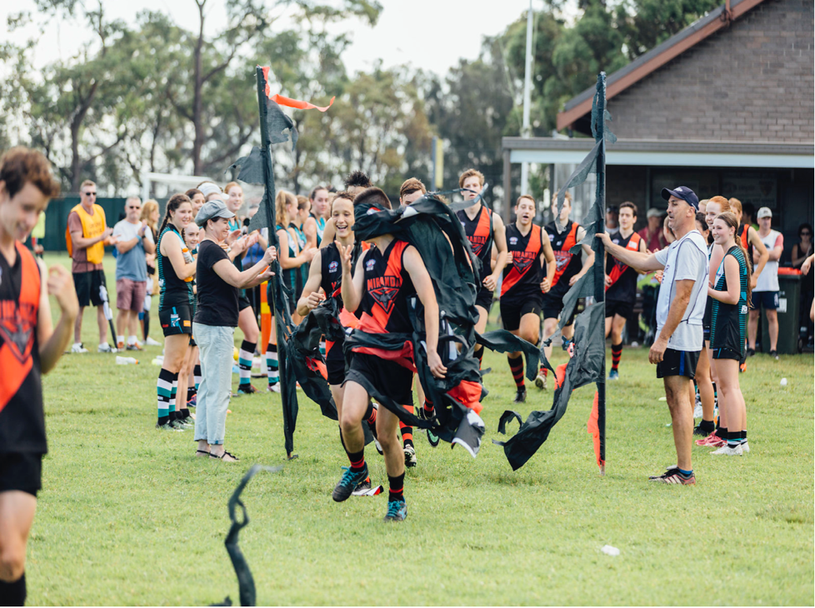

Slide 3

OUR PURPOSE
To provide a quality AFL experience to families from all backgrounds and to foster a lifelong love of the game
OUR CLUB
OUR VALUES
Respect. Enjoyment. Fairness.
Established in 1958 - celebrated 60 years of sport in the Sutherland Shire last year
An inclusive club that promotes fitness and building football skills for girls and boys aged 4-17
An involved community of 30 coaches and managers and over 100 parent helpers
350+ registered players in 2020 from all over the Sutherland Shire

Slide 4
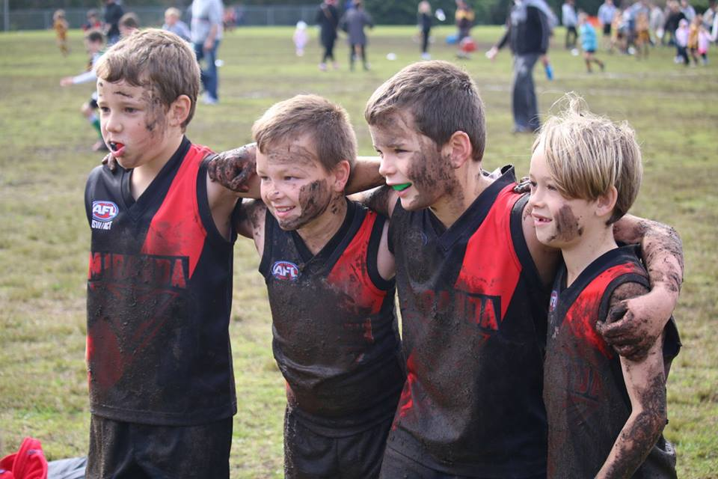

Slide 5
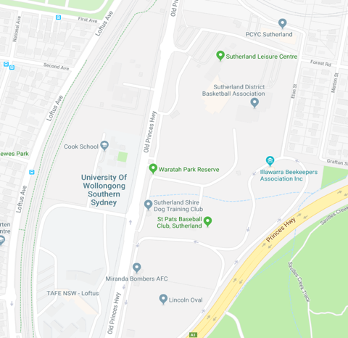


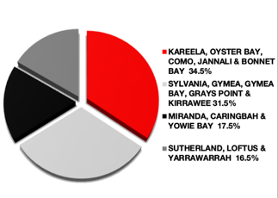
OUR HOME &
COMMUNITY
The $2m redevelopment at Waratah Park is the single biggest investment to infrastructure the AFL and Sutherland Shire Council have ever made in the region.
Waratah Oval is the home of AFL in Sydney’s south – In addition to the Miranda Bombers, it is now home to the Sydney Swans Academy & Southern Power Men’s and Women’s Senior Football (18-39) bringing an additional 300 participants to Waratah Oval regularly each year.

Slide 6
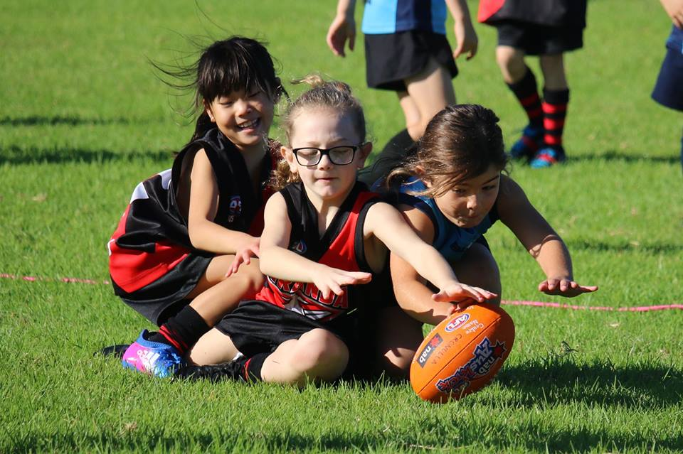

Slide 7
AFL IN THE SHIRE
Since 2006, AFL participation within the Shire has grown between 10-15% each year
The Miranda Bombers have seen a 30% increase in growth since 2018
Over 1000 Shire residents participate in community AFL programs..

Slide 8
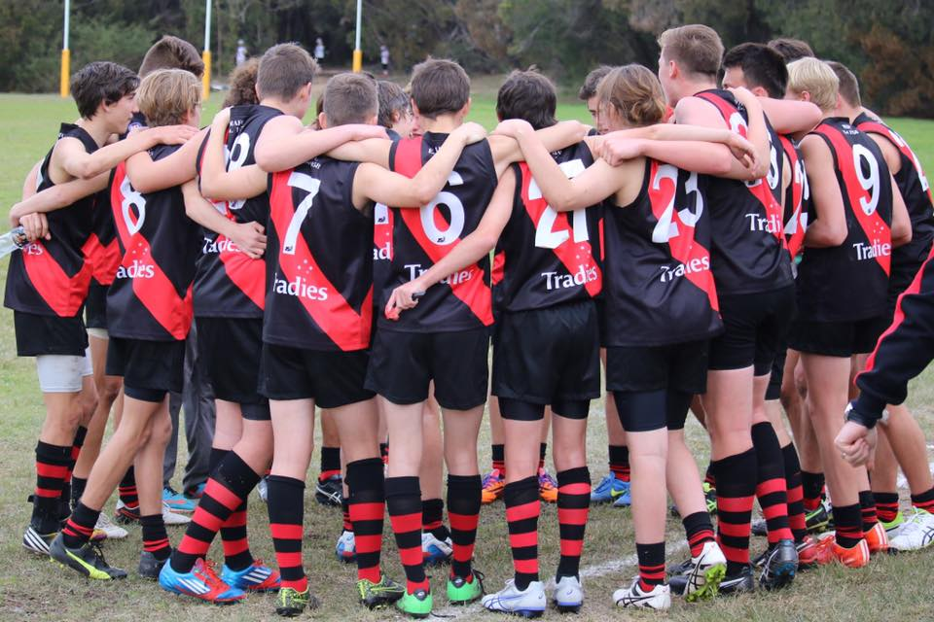
A PREMIER
PARTNERSHIP
We are run by a committed team of skilled volunteers with backgrounds in corporate and small business
One of the longest serving sporting organizations in the Shire – celebrated 60 years in 2018
Align your business with one of Australia’s most successful sporting codes
Showcase your business and commitment to community sport

Slide 9

THE PARTNERSHIP PACKAGES
Logo and contact details on TeamApp
Partnership announcements on social media
TeamApp rotating banner
Option for business name and logo on training shirts*
Prominent tired signage on sponsor’s board at Waratah Oval
Bronze
$1,250 Investment
Incorporates everything in the packages above
Promotional/advertisement on TeamApp & social media
Opportunity to sponsor a home game
Silver
$2,500 Investment
Gold
$5,000 Investment
Incorporates everything in the packages above
Major signage* at ground entrance and/or around field (position to be mutually agreed upon)
In-Kind Partnership
By agreement
Provide goods/services to an agreed value for exposure of equal value
* To be designed and supplied at sponsor’s cost

Slide 10
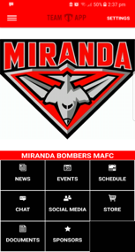
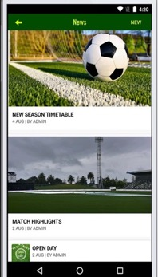
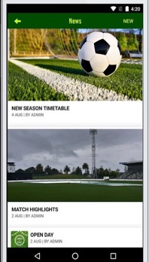
TEAM APP
TeamApp is a customisable app and the ‘one stop shop’ for all Miranda Bomber communication – it’s also the perfect platform to promote your business.
Frequent news and event notifications keep members in the loop about our club and your business
Rotating banner ads on every page so members always know who you, our local supporters are.
Your business’ logo, details + website link on our sponsors page

Slide 11
JOIN OUR CLUB
IN 2021
FOR MORE INFO
Sabrina Smith
Vice President & Footy Mum
0403 812 262
schills2021@hotmail.com
Season start: April ‘21
Season completion: Oct 21’

Slide 12
